Slide 1
Digital Portfolio
STUDENT NAME: JANAVANTH R
REGISTER NO AND NMID: 2428C0476 & D944BE56E07C2B9B1A04176EED175ACF
DEPARTMENT: B.Sc - AIML
COLLEGE: KPR COLLEGE/ BHARATHIYAR UNIVERSITY

Slide 2
PROJECT TITLE
Personal and Publication Portfolio Website.

Slide 3


AGENDA
Problem Statement
Project Overview
End Users
Tools and Technologies
Portfolio design and Layout
Features and Functionality
Results and Screenshots
Conclusion
Github Link
3/21/2024 Annual Review

Slide 4

PROBLEM STATEMENT
Many researchers and journal authors lack a centralized digital portfolio to showcase their publications, achievements, and research impact effectively. Relying on traditional CVs or scattered academic profiles often fails to highlight expertise, track citations, or present work in a visually appealing and accessible way. In today’s competitive academic environment, a well-designed author portfolio can help attract collaborations, funding opportunities, and greater visibility, making it easier for peers, institutions, and publishers to explore an author’s contributions in one organized platform.

Slide 5

PROJECT OVERVIEW
Centralized Repository – Collect and maintain all publications (journals, conferences, books, patents) in one platform. Enhanced Visibility – Improve academic reach, global discoverability, and citation impact. Authenticity & Integration – Link with DOI, ORCID, Scopus, PubMed, Google Scholar for validation and credibility. Research Networking – Enable collaborations by showcasing expertise and research interests.

Slide 6

WHO ARE THE END USERS?
Researchers showcasing their publications, research areas, and academic impact
Journal Authors maintaining a professional portfolio to highlight their written works
Institutions & Universities evaluating faculty contributions and academic achievements
Publishers & Editors reviewing author profiles for collaborations or editorial opportunities
Funding Agencies & Collaborators assessing research expertise for grants and partnerships

Slide 7

TOOLS AND TECHNIQUES
HTML CSS JavaScript Git and GitHub VS Code

Slide 8
POTFOLIO DESIGN AND LAYOUT
Home / About the Author – Brief academic introduction, expertise, and research focus Publications – Organized list of journals, conference papers, books, and citations with filters (by year, topic, or type) Research Skills & Areas – Key skills, methodologies, and specializations Collaborations & Achievements – Awards, grants, editorial roles, or major projects Contact / Networking – Institutional affiliation, professional email, ORCID, LinkedIn, Google Scholar links Responsive Layout – Optimized for desktop, tablet, and mobile viewing.
8

Slide 9
FEATURES AND FUNCTIONALITY
Easy navigation to all sections Publications with titles, abstracts, and links Research metrics like citations and h-index Search and filter to find specific works Contact form for collaboration Works smoothly on all devices

Slide 10
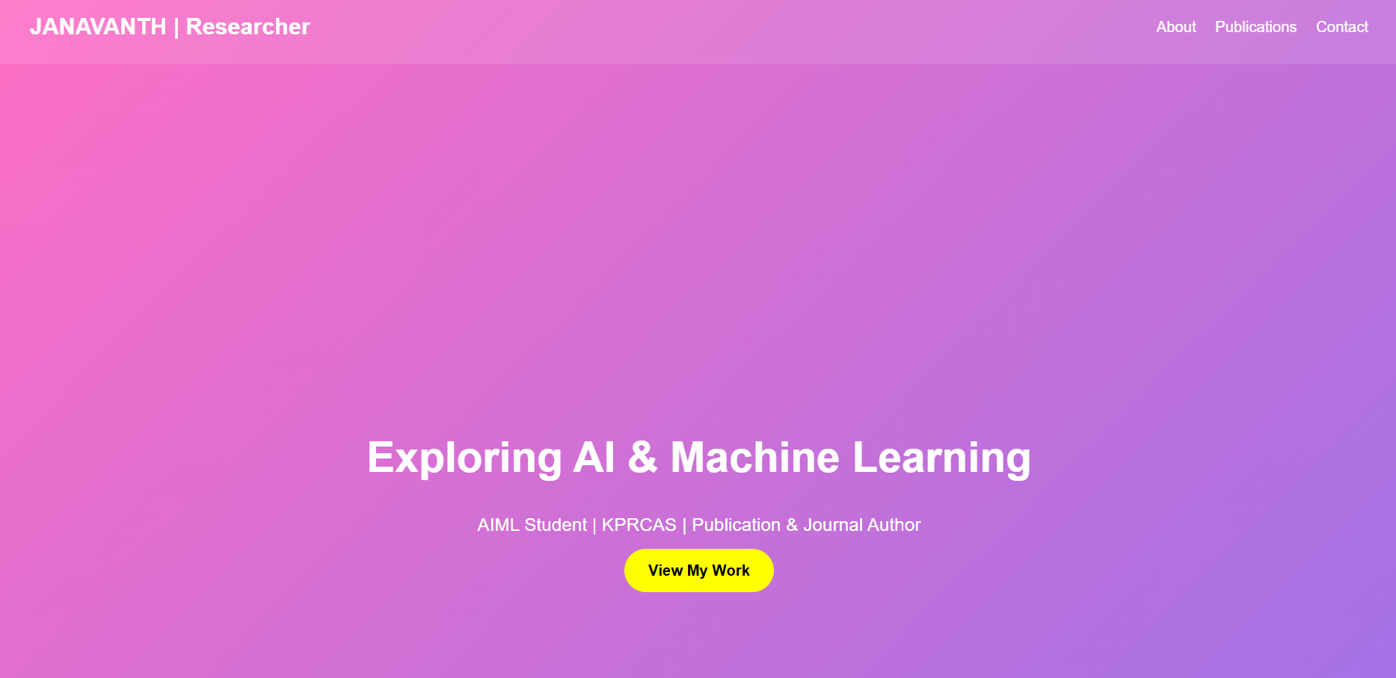

RESULTS AND SCREENSHOTS
3/21/2024 Annual Review
10

Slide 11
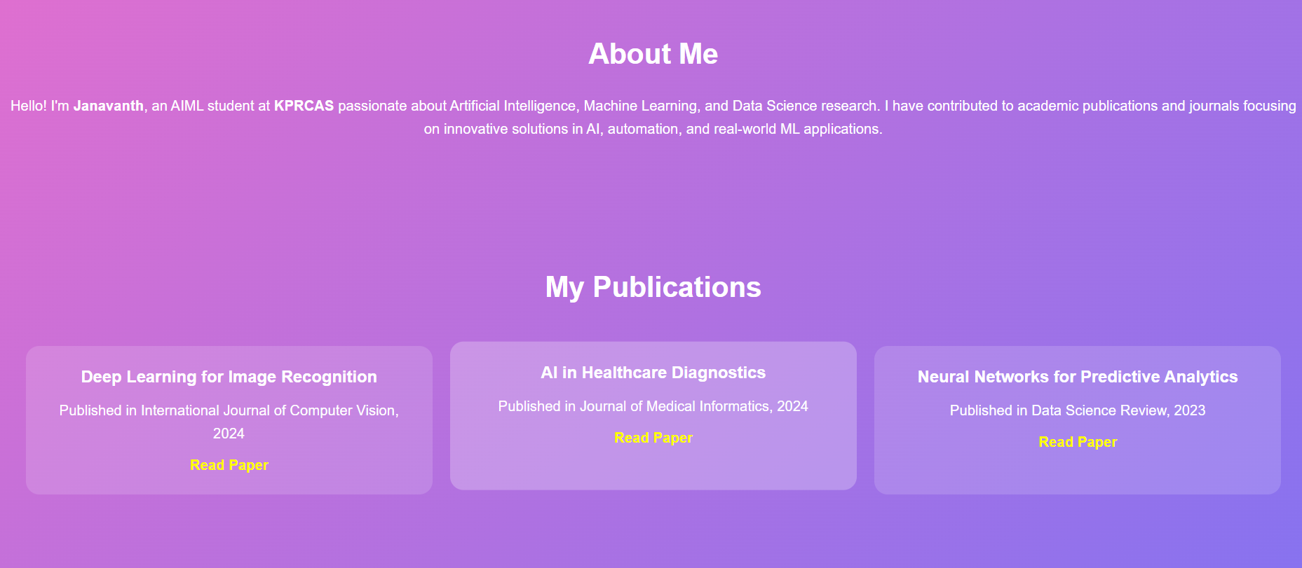
RESULTS AND SCREENSHOTS
3/21/2024 Annual Review
11

Slide 12
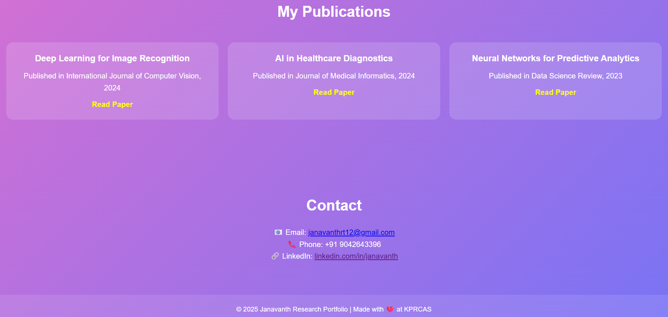
RESULTS AND SCREENSHOTS
3/21/2024 Annual Review
12

Slide 13
GITHUB LINK
https://github.com/janavanthrt12

Slide 14
CONCLUSION
Showcases my publications and research impact. Summarizes my academic journey and achievements. Helps peers and institutions understand my expertise. Makes it easier for collaborators, publishers, and funding agencies to connect with me.
14

